Slide 1
Uploading images to Canto
Step-by-step guide for Canto contributors
July 2024

Slide 2
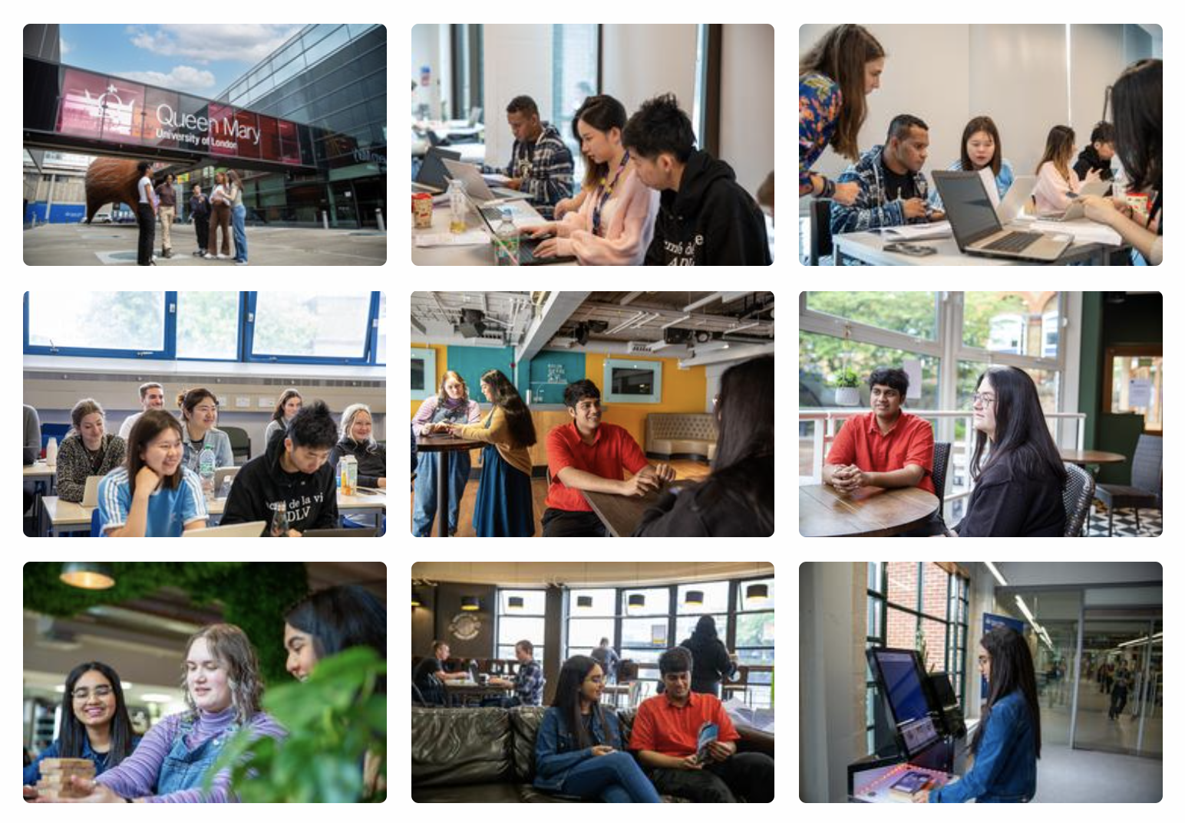
This guide covers…
Image guidelines
Consent and permissions
Image subject and quality
Preparing and uploading files
Naming files on your computer
Uploading files to the contributor folder
Adding metadata
Tagging images correctly

Slide 3
Image guidelines
Consent and permissions

Slide 4
Consent and permissions
Why is consent important?
You have a legal responsibility to ensure that your images have the appropriate consent from everybody included, and that you have the appropriate permissions from the photographer to use and distribute the images.
How do I collect consent?
The Content and Brand team have a centralised digital consent form that you can send to people. Using this form ensures all consent is correctly logged and monitored.
To use this form, contact content@qmul.ac.uk to ask for a job number and form link.
Expired consent
We do not use images or videos featuring people if they are more than five years old.
Contact content@qmul.ac.uk for the latest consent form link

Slide 5
Consent and permissions
When is a consent form needed?
Below are a list of scenarios in which you would need those included to complete a consent form, and when a polite notice would suffice instead.
Contact content@qmul.ac.uk with any questions
Consent forms are required when –
Assets are in a controlled environment (eg not in public)
Assets contain individuals or groups of students who are identifiable
Polite notice suffices when –
Assets are in a public setting
Individuals or groups of students are not identifiable
The asset is of a public figure or high-profile member of staff
There are no close-ups

Slide 6
Consent and permissions
Permission of the image owner
Before using an image, you also need to make sure that you have the permission of the image owner.
Who owns what?
Generally, the image is owned by the individual who created it OR the individual's employer (if they created it at work). The copyright symbol does not have to be present for copyright to exist, so it is best to assume that images you find online (except when using the platforms we list below) are protected by copyright.
Avoid ‘copyright free’ images you find online
Permissions can change, so if you download a 'copyright-free image' online from a source we have not provided to you, you may find yourself in breach of copyright rules.

Slide 7
Image guidelines
Image subject and quality

Slide 8
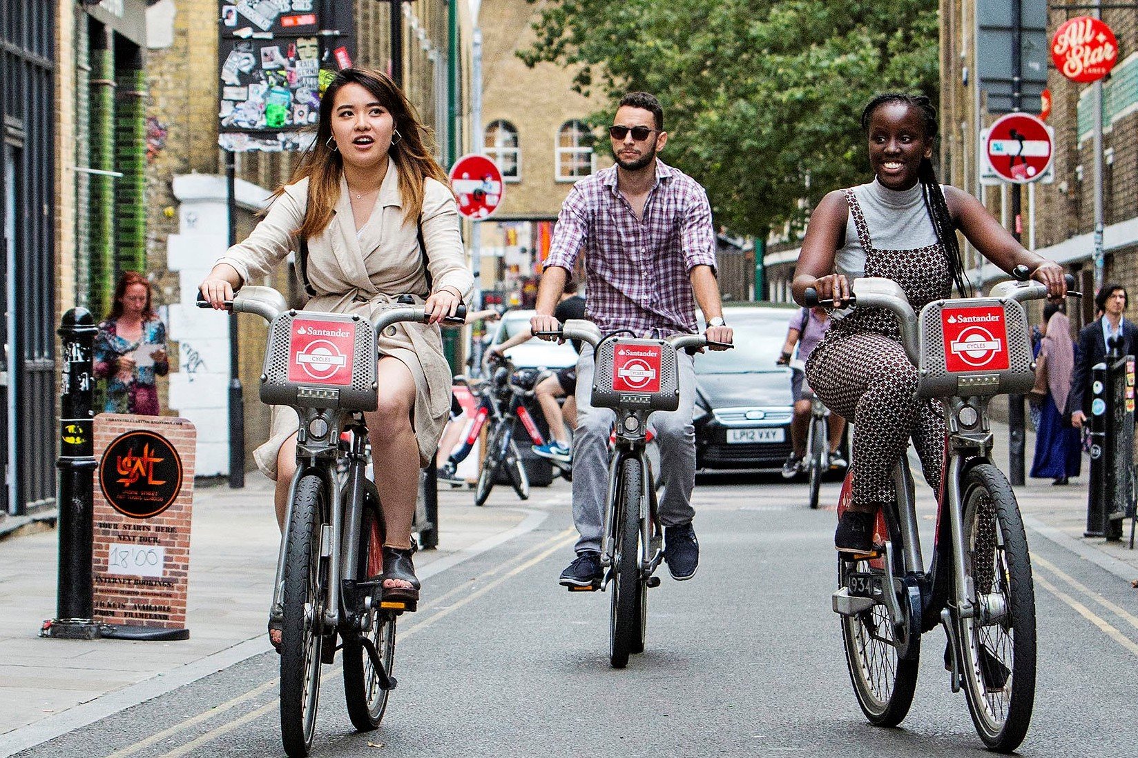
Image guidelines
Choosing a subject for your image
The subject can be interpreted as the “what” in the image. Examples might include -
People
Actions or activities
Buildings or notable locations
Make sure to include shots of compelling subject matter containing plenty of information about the scene. In the next slides, we have highlighted some good and bad examples.

Slide 9
Image guidelines
Image quality
Quality
High-resolution photos are required for sharp reproduction in publications. Even if you yourself don't intend to print the image, all images on Canto must be appropriate to print. Images should -
Be set up as 300 dpi or, if unknown, the file size should be at least 3MB
Be well focused (avoid blurry images) and have balanced lighting (not too dark, not too bright)
Get in touch with content@qmul.ac.uk with any questions.

Slide 10
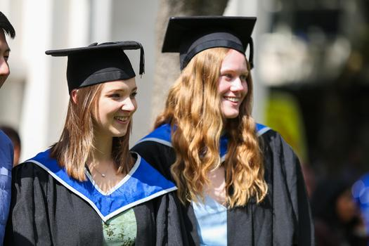
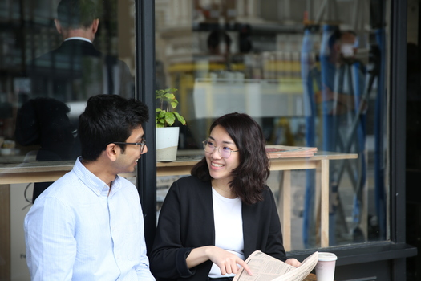
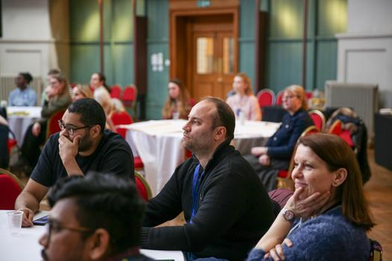

Image guidelines
Good examples (people)
In images focusing on people, whether they are of groups or individuals, we should be able to see their faces and facial expressions.

Slide 11
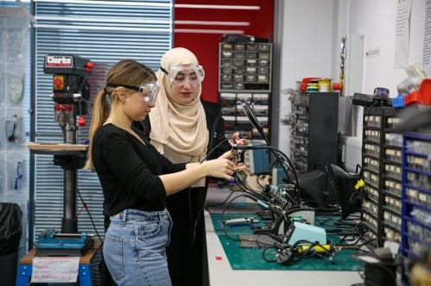
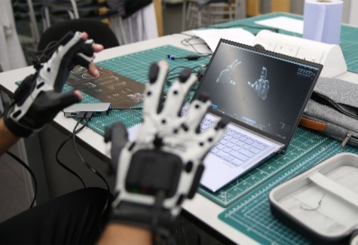
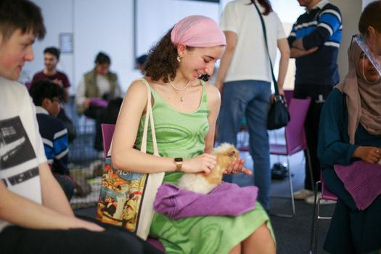
Image guidelines
Good examples (actions and activities)
Make sure the action or activity taking place is engaging and clear within the image.

Slide 12
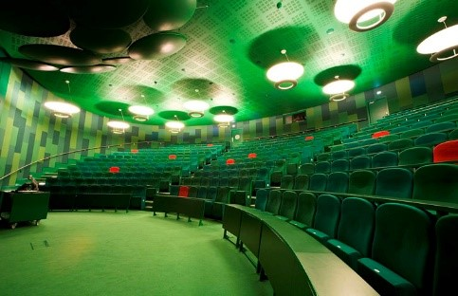
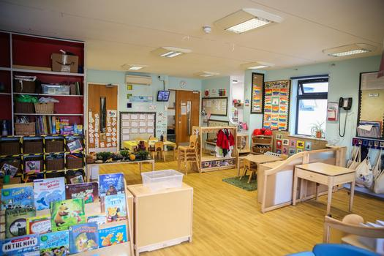
Image guidelines
Good examples (buildings and spaces)
Make sure the image provides context and showcases the whole space.

Slide 13
Preparing and uploading files
Naming files on your computer

Slide 14
Preparing and uploading files
Naming files on your computer
You will need to prepare your files by naming them before you upload them to Canto. Renaming your images will make them accessible to people using screen readers and also make your images easier to find.
Option 1
If you have been allocated a Content and Brand job number, you can name your images like this –
[Job number]_[Project name]_[Image number]
Eg 765-23_Festival of Communities_1
Option 2
If you have not been allocated a Content and Brand job number, you can name your images like this, adding the year the image was created –
[Project name]_[Year]_[Image number]
Eg Festival of Communities_2023_1

Slide 15
Preparing and uploading files
Uploading files to contributor folder

Slide 16
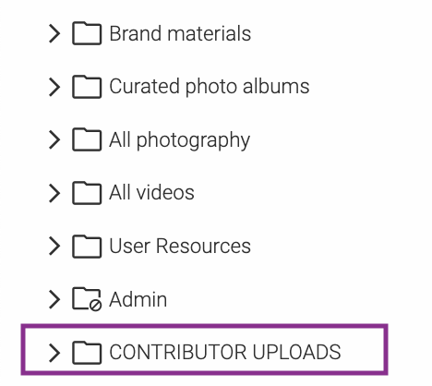

Preparing and uploading files
Creating an album in the Contributor folder
You can upload your files to the ‘Contributor uploads’ folder.
Select the ‘Contributor uploads’ folder in the menu
Select the ‘New album’ button in the bottom left
Contributor upload album
New album button

Slide 17

Preparing and uploading files
Uploading images to your new album
You can add images to your album in one of two ways –
Drag and drop files directly into a Canto album
Click on the button and select the files you wish to upload
Upload files button

Slide 18
Adding metadata
Adding data in bulk or individually

Slide 19
Adding metadata
Adding data in bulk or individually
Metadata is data describing other data. In this instance, things like descriptions and tags.
Adding bulk metadata
When you upload files from your laptop, you will be prompted to bulk add metadata. Fill in the fields applying to all images in this way.
Adding image-specific metadata
You can then add image-specific tags. Eg image-specific tags.
It is possible to edit metadata after you have uploaded images, but make sure to be as accurate as possible from the beginning.

Slide 20
Adding metadata
Glossary of metadata terms

Slide 21
Adding metadata
Descriptions
When adding bulk descriptions, write a few sentences to summarise the project/group of assets. For example –
  Name of the event
  Date images were taken
  Image location
When adding image-specific description, describe the assets so that users will find them in searches and understand what is shown. For example –
  Staff members included

Slide 22
Adding metadata
Keywords
Choose at least one keyword (preferably more) from the dropdown list to help categorise your images. Your keywords should capture the nature of the content. For example -
  Events
  Staff
  Student Life
  Research and Innovation

Slide 23
Adding metadata
Tags
Add specific and consistent tags to help users find your content in searches. You can add multiple tags by separating them with a comma.
Use one of the autocomplete suggested tags where relevant to maintain consistency in tagging and help users find assets.
Automatic smart tags will attach using AI technology. Check if these are relevant to the asset and accurate and delete accordingly
Use full name and add acronym afterwards in brackets. Eg Digital Environment Research Institute (DERI)

Slide 24
Adding metadata
Author
Queen Mary staff
Use both the name of the Queen Mary staff member who produced the asset and 'Queen Mary' for in-house produced asset.
Eg Amelie Ko/Queen Mary University of London
External freelancer
Use partner or freelancer name if created externally and licensed for Queen Mary use.
Eg Jonathan Cole

Slide 25
Adding metadata
Digital Rights Management - Licence
This will normally be 'Queen Mary Licence', but below are the options and what they mean.
Queen Mary Licence – Queen Mary Copyright (Eg created by a Queen Mary staff member)
Partner Licence – External copyright (Eg the content was produced by someone outside of Queen Mary) and licensed for Queen Mary use
Restricted Licence – Additional permissions need to be sought by staff before using

Slide 26
Adding metadata
Copyright
Add the name of the copyright holder.
For Queen Mary produced assets, it will be 'Queen Mary University of London'.
If produced by a partner, such as a freelancer, check the terms of agreement to establish who holds copyright.

Slide 27
End slide

