Slide 1
Canto imagery criteria
Guidance around images appropriate for Canto
November 2023

Slide 2
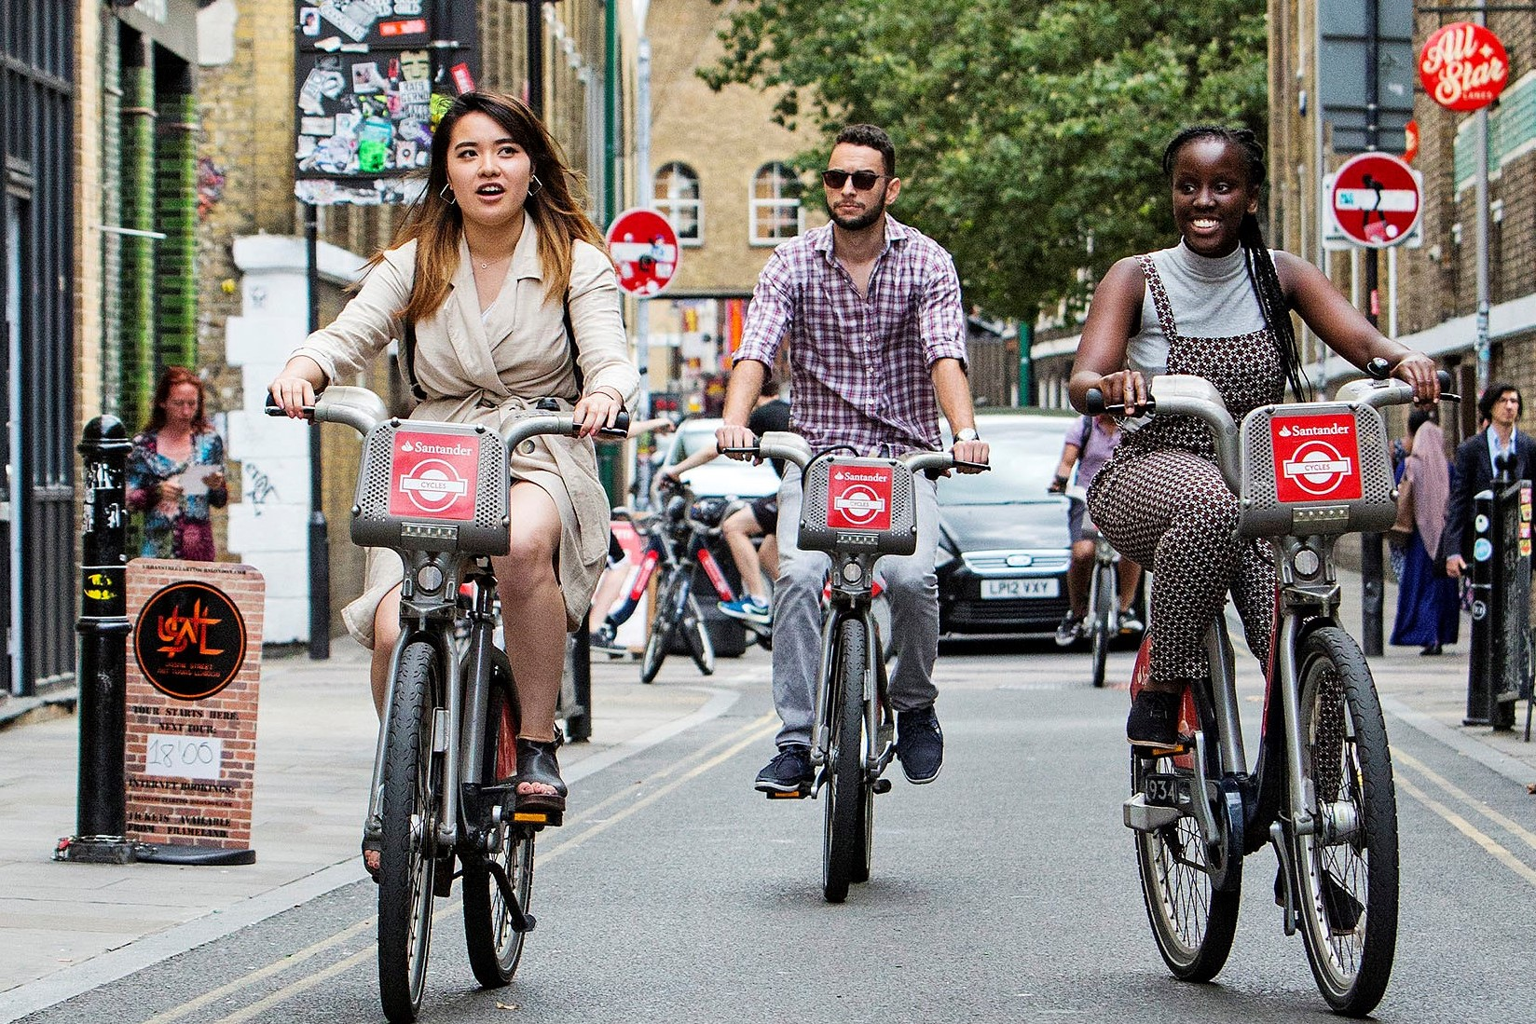
Image guidelines
Choosing a subject for your image
The subject can be interpreted as the “what” in the image. Examples might include -
People
Actions or activities
Buildings or notable locations
Make sure to include shots of compelling subject matter containing plenty of information about the scene. In the next slides, we have highlighted some good and bad examples.

Slide 3
Image guidelines
Quality and consent
Quality
High-resolution photos are required for sharp reproduction in publications. Even if you yourself don't intend to print the image, all images on Canto must be appropriate to print. Images should -
Be set up as 300 dpi or, if unknown, the file size should be at least 3MB
Be well focused (avoid blurry images) and have balanced lighting (not too dark, not too bright)
Copyright and permissions
You need to ensure that your images have the appropriate consent from everybody included, and that you have the appropriate permissions from the photographer to use and distribute the images.
We do not use images or videos featuring people if they are more than five years old.
Get in touch with content@qmul.ac.uk if you have any further questions.

Slide 4
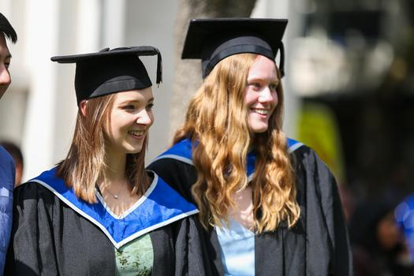
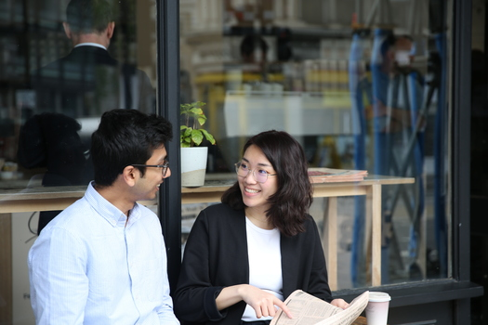
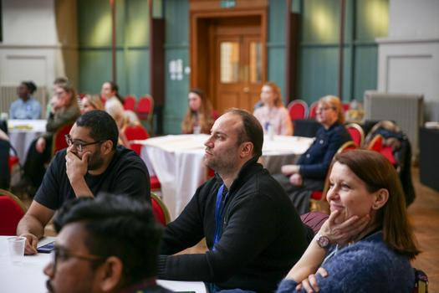

Images of people
Good examples
In images focusing on people, whether they are of groups or individuals, we should be able to see their faces and facial expressions.

Slide 5
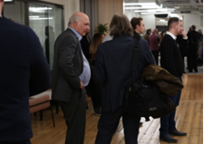
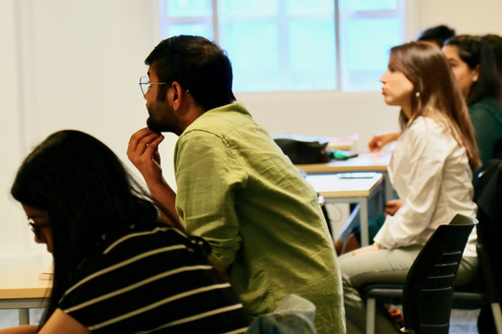

Images of people
Bad examples
Avoid uploading any images where all the people in the image are blurred, or we cannot see their faces and facial expressions (Eg they are turned away from the camera)

Slide 6
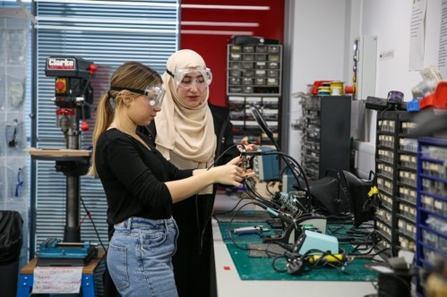
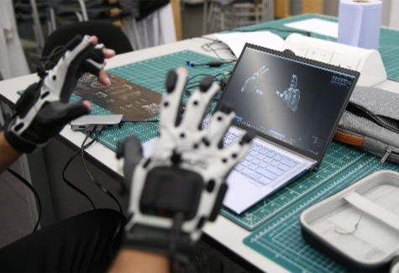
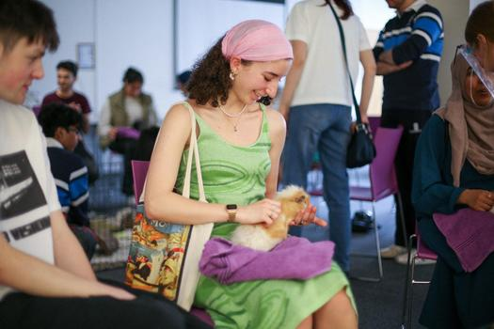
Images of actions or activities
Good examples
Make sure the action or activity taking place is engaging and clear within the image.

Slide 7
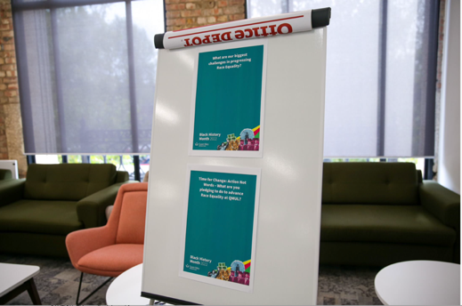
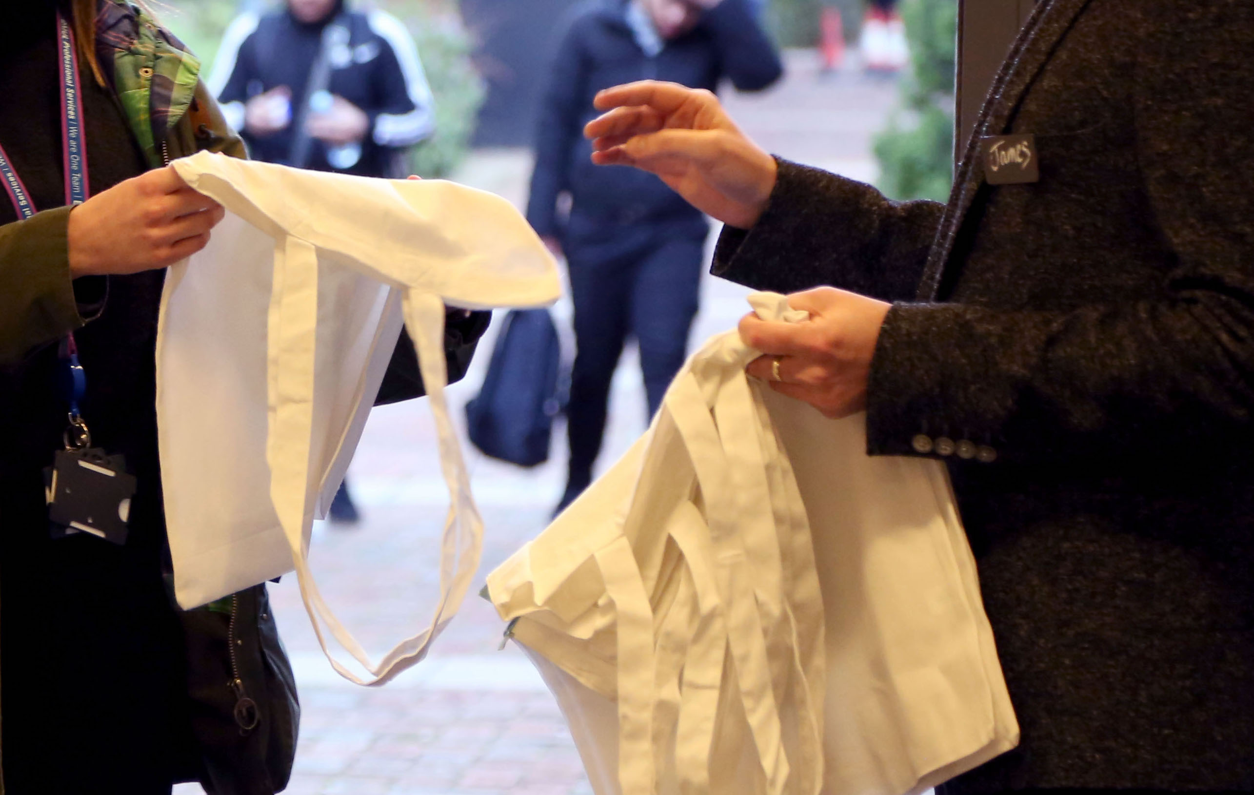
Images of actions or activities
Bad examples
Avoid including empty spaces or dull subject matter.

Slide 8
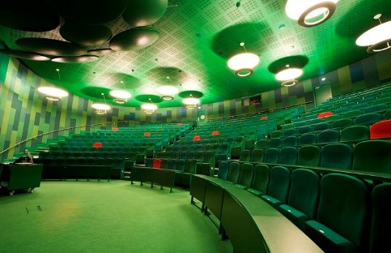
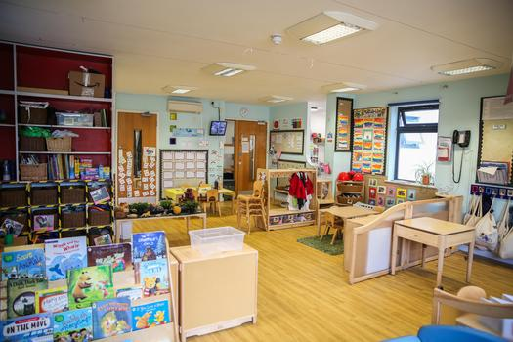
Images of buildings or notable locations
Good examples
Make sure the image provides context and showcases the space as a whole.

Slide 9
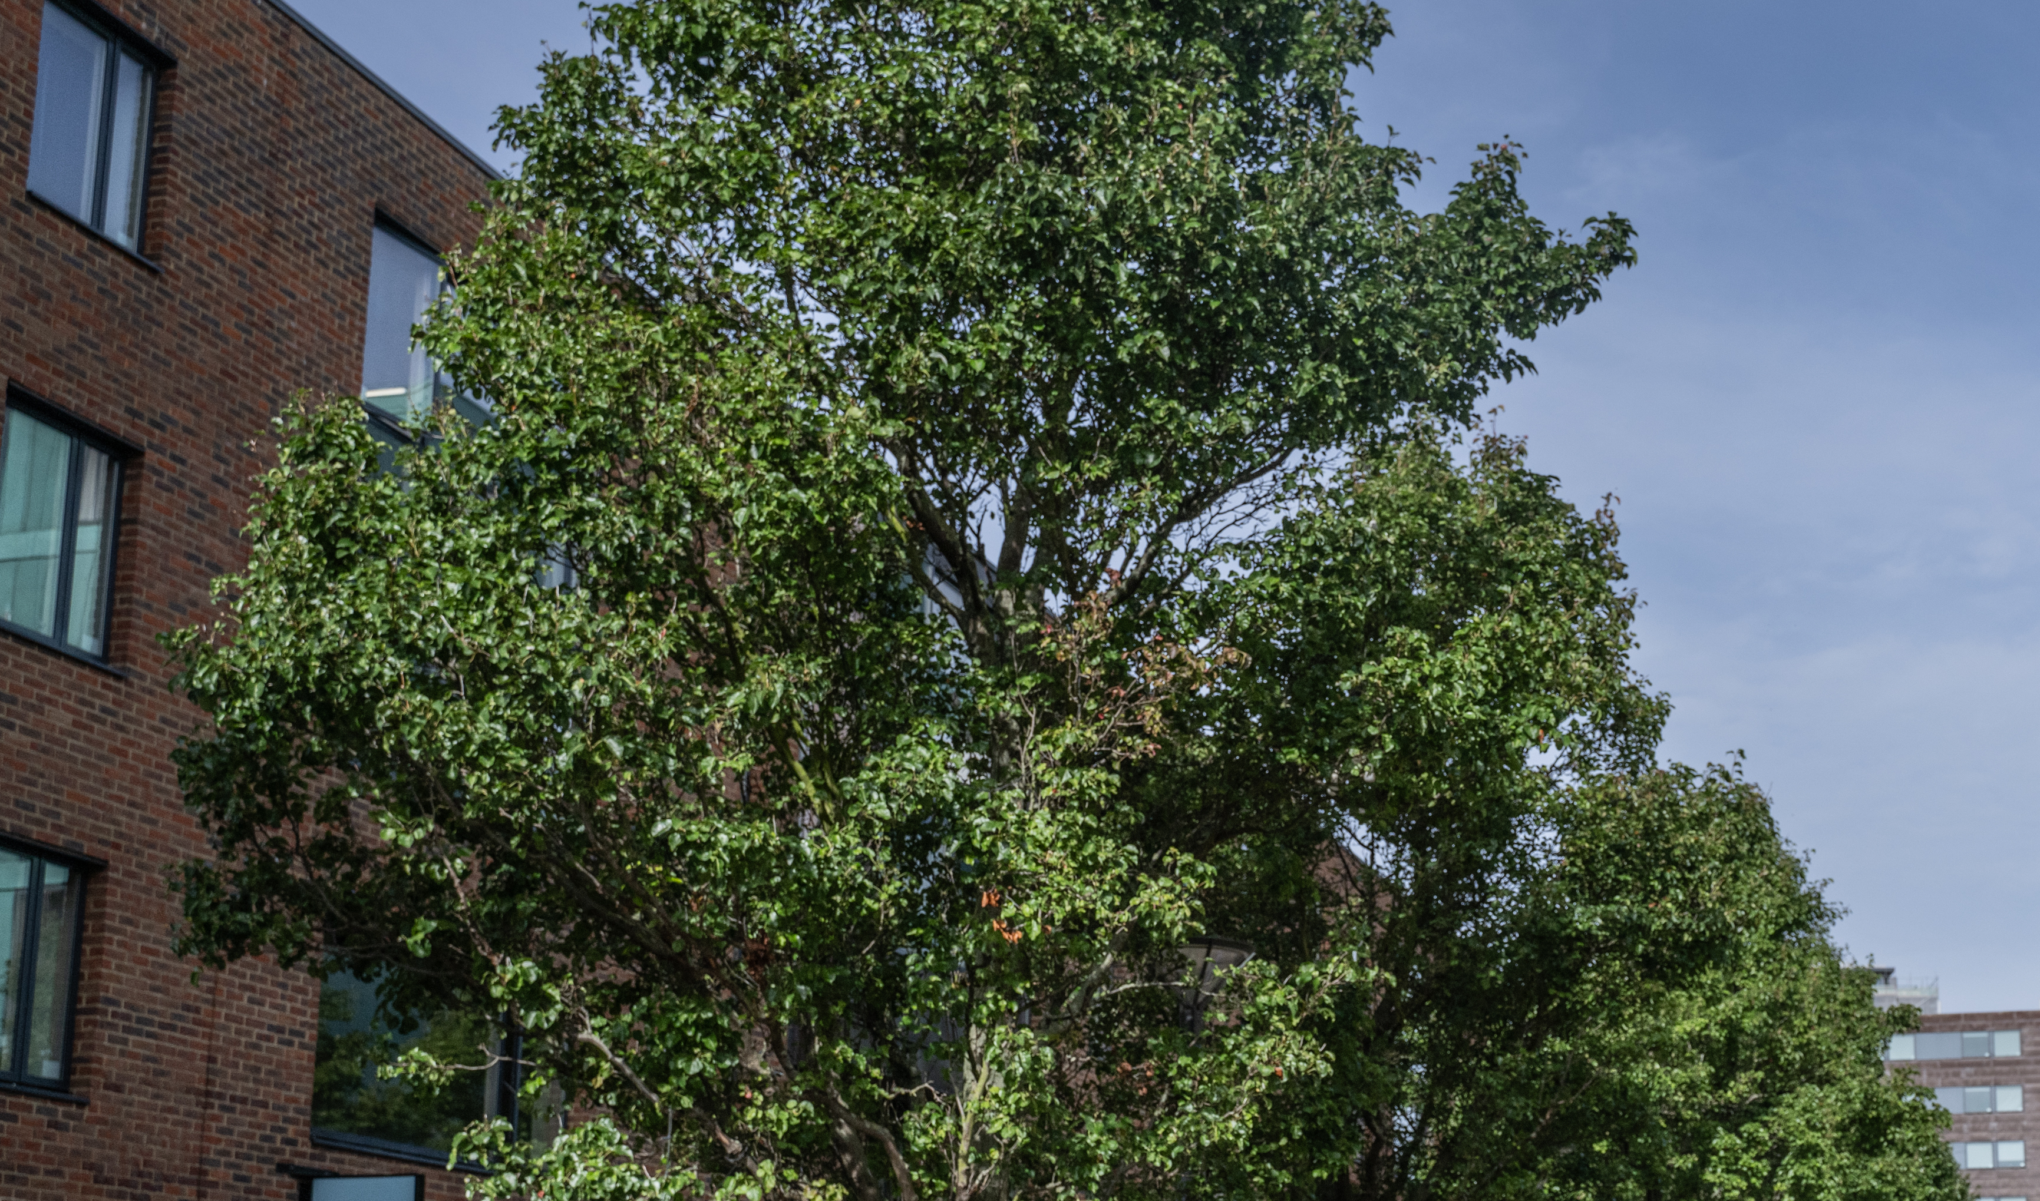
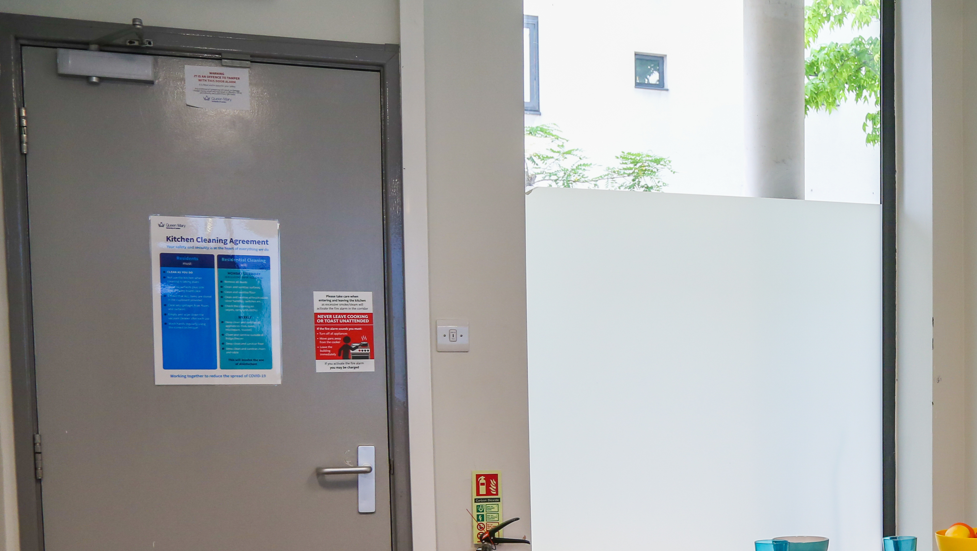
Images of buildings or notable locations
Bad examples
Avoid uploading images offering no real context to the building or space.

Slide 10
End slide

