Slide 1
Canto user guide
Guidance on searching for and downloading images
October 2025

Slide 2

Why use Canto?
Canto is Queen Mary’s official media library. All images uploaded to Canto can be used across University materials, and have the appropriate -
Copyright permissions
Consent
Quality
Images downloaded from Canto should only be used for Queen Mary assets, such as printed materials, the website and social media.

Slide 3
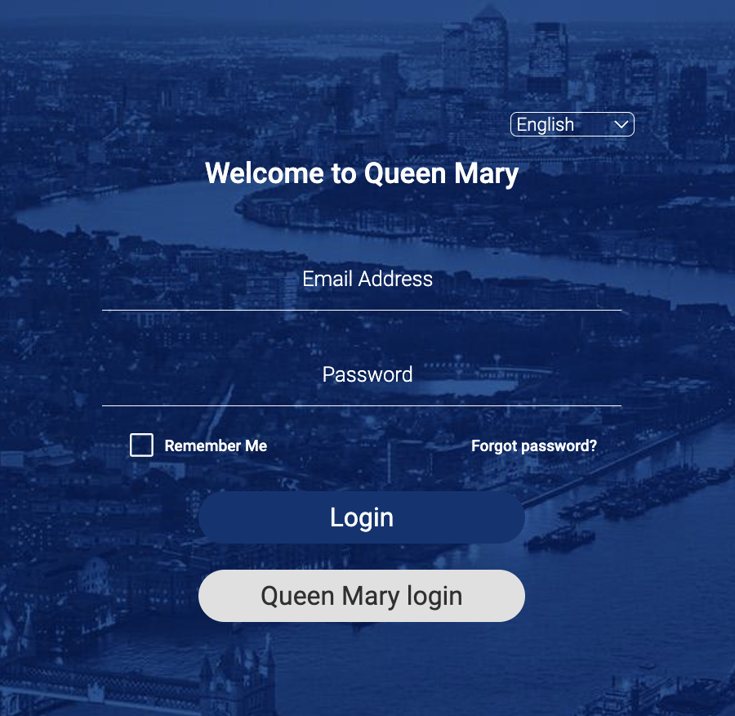
How do you login?
All Queen Mary staff members, regardless of their role, should have User access to Canto. This means they can download images and files from the platform.
You can log in using your existing Queen Mary details. Learn more about Canto access.
For new starters
Your line manager will need to request access 'Standard User' access for you. They can request this by contacting ITS.
Access Canto

Slide 4
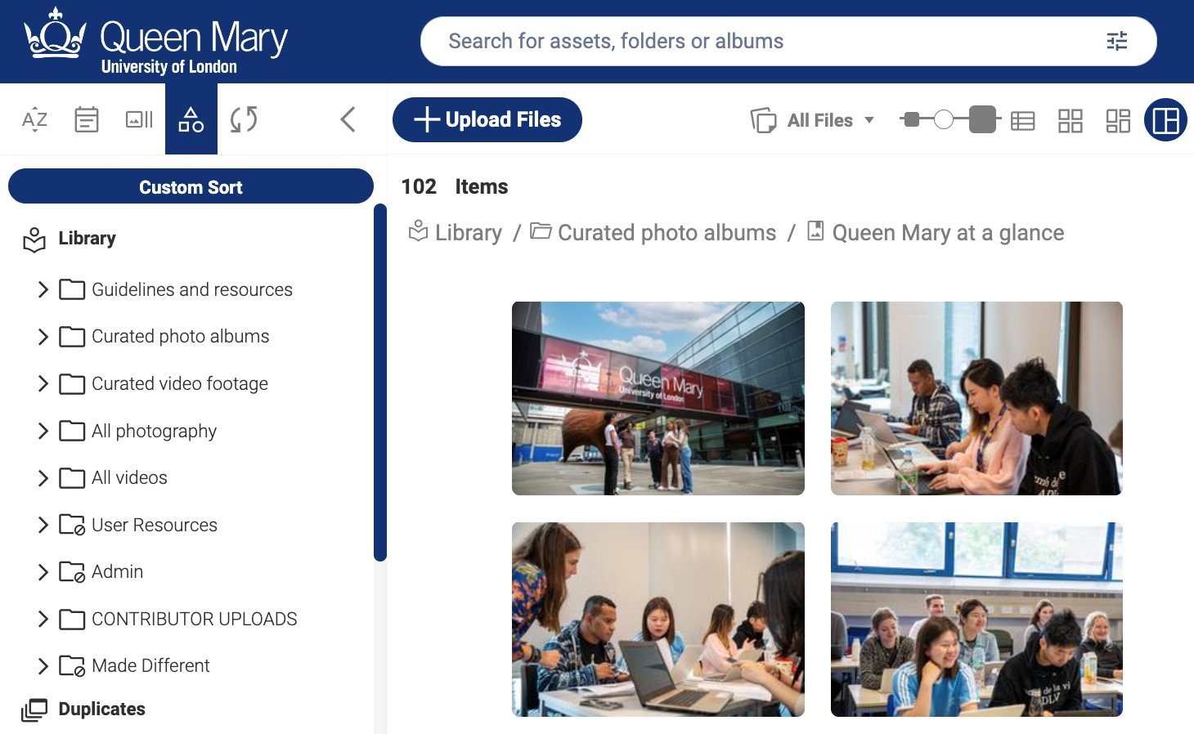
Searching Canto
You can search for media on Canto in multiple ways.
Search bar
Search for assets using key words.
Curated albums
Top-level albums for key categories such as our campuses and events.
Upload albums
All uploaded albums to be searched by upload date and then project name.
Search bar, curated albums and all upload albums

Slide 5
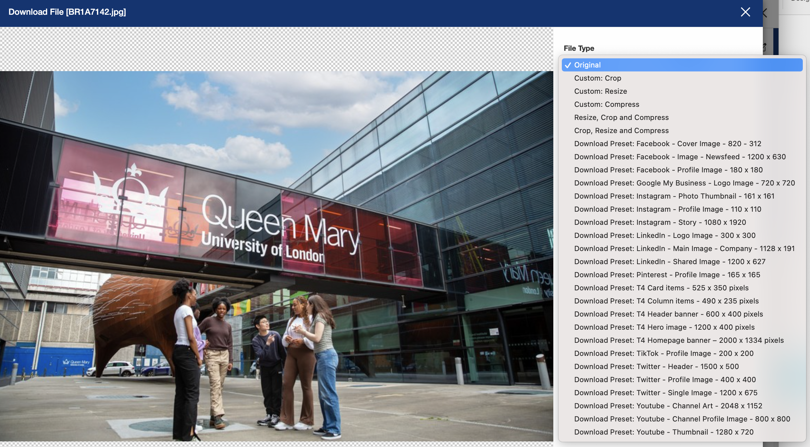

Downloading images
You can download images individually, or in bulk, by selecting the image(s) and clicking the download button.
Adjusting media​
There are a variety of tools to adjust media to suit your needs before downloading, such as cropping and resizing.​
You can use presets to suit T4 content types or social media platforms.​
Image dimension options

Slide 6

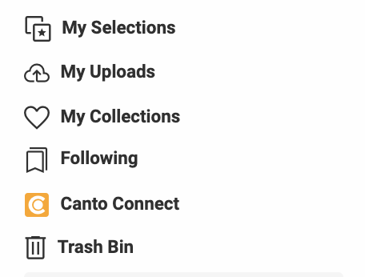

Following files and creating collections
Following files
You can follow a file on Canto by selecting the bookmark icon. This will mean you receive an email update whenever the file is amended.
We recommend following our guideline documents so that you can always have the most up-to-date version.
Creating collections
Your collections on Canto are a lot like your bookmarks in an internet browser. You can add files to your collection by clicking the heart icon.
Access files you have followed or added to your collections via the menu on the left

Slide 7
End slide

