Slide 1
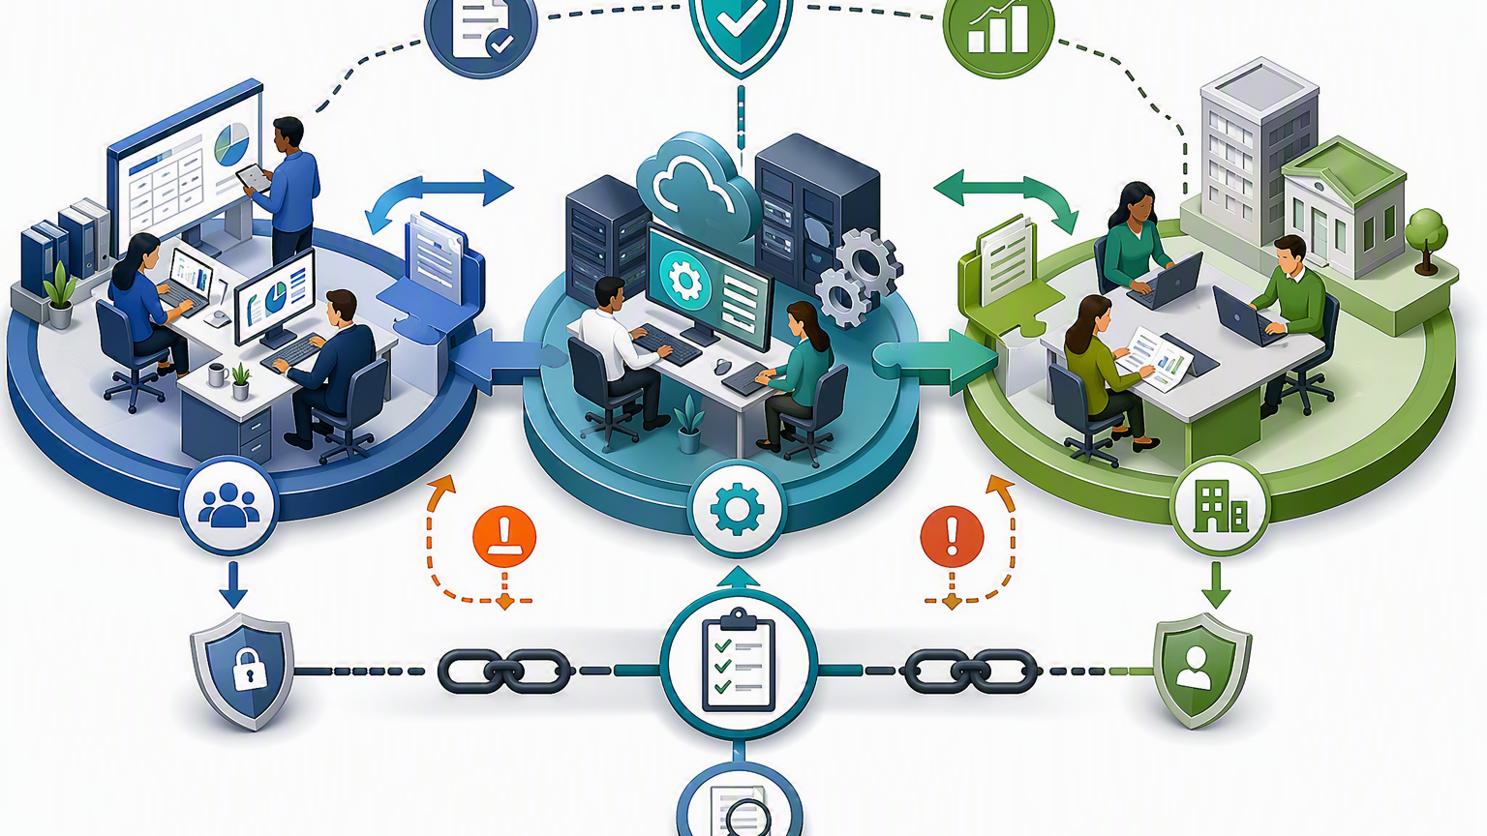
Training Session
Unit4 Batch Input Maintenance
& File Processing
Friday 17 July 2026 | 10:00–11:00 | Microsoft Teams
Accuracy
Auditability
Clear ownership
Purpose: reduce avoidable BIM errors, improve the reliability of financial processing, clarify responsibilities
Alison Mavis
Business Systems Manager (Finance Systems)
Notes:
Opening: Welcome attendees, position the session as practical and preventative, and explain that the purpose is to reduce errors and clarify when to correct or escalate. Emphasise that this is not a blame exercise.
[Sources]
- Meeting invite states the session covers Unit4 file processing, Batch Input Maintenance, error mitigation, correction routes, responsibilities, escalation and business benefits. Reference: turn1search3.
- Visual on this slide was generated with Microsoft Copilot.

Slide 2
Session aims and agenda
What we will cover
Why we are here
Expected outcomes
Session approach
The purpose of today’s session
Explain the BIM and file-processing process
Explain what to do when transactions fail validation or appear in Batch Input Maintenance
Reduce avoidable errors
Aim - explain why and how & reduce rework and improve user confidence.
Understand why items appear in BIM
Recognize common validation issues
Know when to correct, pause or escalate
Understand responsibilities and support routes
Short explanations
Practical examples
Clear do/don't guidance
Questions and scenarios
Recording, follow-up guidance, FAQ's
Running Order
10:00
Welcome and objectives
10:05
File processing lifecycle
10:15
What’s BIM & why items land there
10:30
Corrections, responsibilities and escalation
10:45
Scenarios, questions and common issues
10:55
Golden rules and next steps
Notes:
This slide can be used to set expectations at the start. The timings are suggested so you keep the session practical and complete within the hour.
[Sources]
- Meeting invite states the session covers why errors occur, BIM purpose, common posting errors, corrections, responsibilities, escalation, FAQs and expected outcomes. Reference: turn1search3.

Slide 3
What is Batch Input Maintenance (BIM)
Why good BIM handling matters
Batch Input Maintenance (BIM) is a Unit4 function used to review and manage transactions that have been imported into the system
but
have failed validation checks and therefore cannot be posted automatically to the ledger.
Transactions appearing in Batch Input Maintenance require investigation before they can be EITHER
  successfully posted
  or
  DELETED.
Notes:
Talk track: connect the training to business benefits, not just system administration. Reinforce that better handling supports accuracy, auditability and faster resolution.
[Sources]
- Meeting invite lists business benefits including reduced processing delays, improved financial data quality, fewer support requests, faster resolution, better month-end efficiency, enhanced auditability, clarified responsibilities and minimised operational risk. Reference: turn1search3.

Slide 4
What Batch Input Maintenance is for
Control point, not casual amendment area
BIM helps identify failed or incomplete processing
BIM supports correction and investigation
BIM protects data quality and auditability
When transactions fail validation, BIM provides a controlled place to review the issue before posting continues.
The aim is to understand the failure, correct the underlying issue where appropriate, or escalate when the cause is unclear.
Correct handling reduces the risk of duplicate action, incorrect posting and unclear correction trails.
Key message
If you are not clear why a transaction has failed, pause and escalate with the batch details rather than making repeated amendments.
discussion question: “What information do you check before amending a batch record?”
Notes:
Use this slide to land the behavioural message. The content from the meeting invite includes when Finance users should and should not amend batch records; this slide turns that into practical guidance.
[Sources]
- Meeting invite states the session covers the purpose of Batch Input Maintenance and when Finance users should and should not amend batch records. Reference: turn1search3.

Slide 5

Transaction processing lifecycle
From file to posting
Notes:
Talk through the journey: source/import file, upload or interface, validation, BIM/holding area if validation fails, correction or escalation, and eventual posting. Use this as a conceptual explanation, not as a detailed Unit4 procedure.
[Sources]
- Meeting invite states the session covers how interface and import files are processed within Unit4, what happens when transactions fail validation, and the purpose of Batch Input Maintenance. Reference: turn1search3.
- Visual on this slide was generated with Microsoft Copilot.

Slide 6
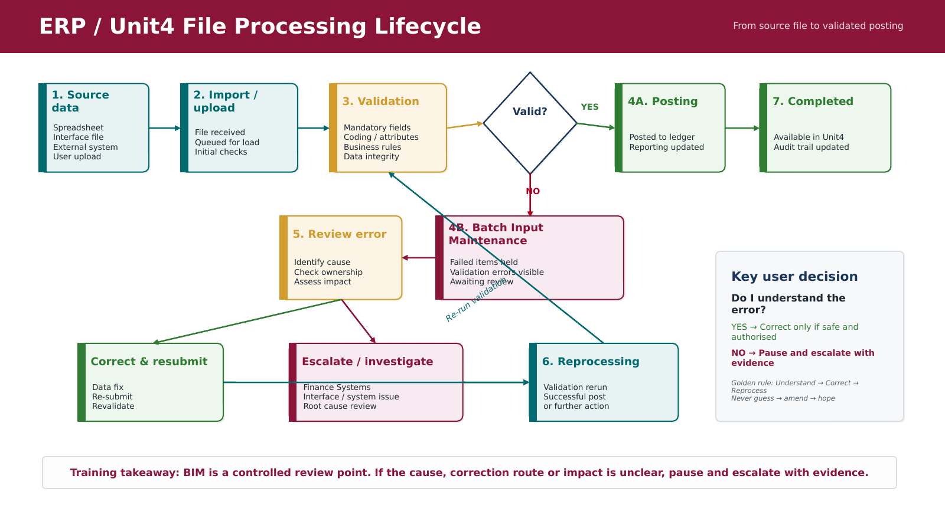

Slide 7
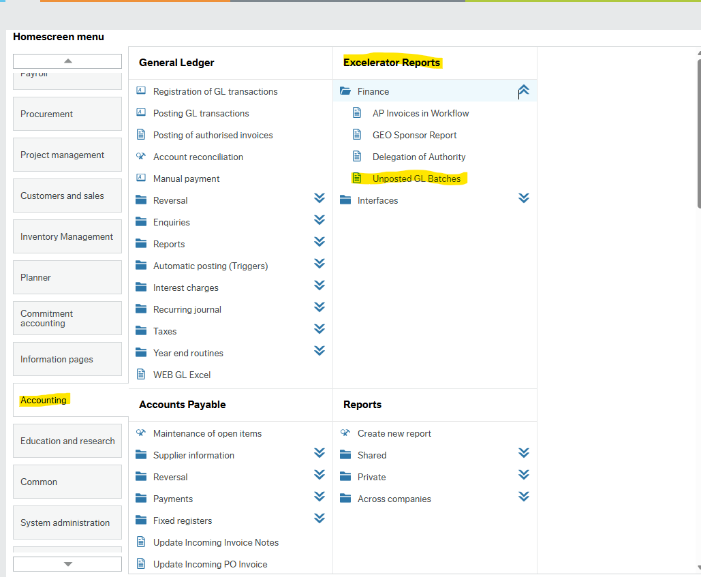
Visibility of BIM items - Report
Who does what?
Homescreen menu - Unit4 ERP
Notes:
Position this as a practical working model and confirm where there are exceptions. The meeting invite explicitly states the need to clarify responsibilities between Finance users and Finance Systems.
[Sources]
- Meeting invite states the session covers responsibilities of Finance users versus the Finance Systems team, escalation routes and support arrangements. Reference: turn1search3.
- Visual on this slide was generated with Microsoft Copilot.

Slide 8
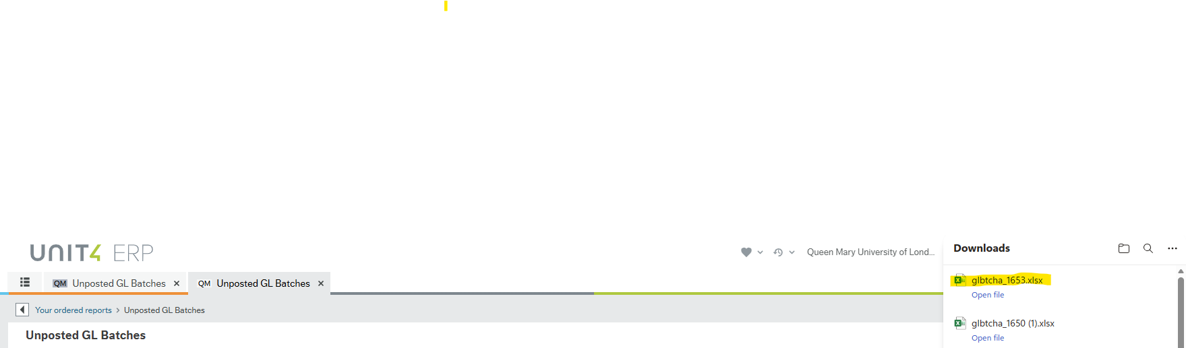
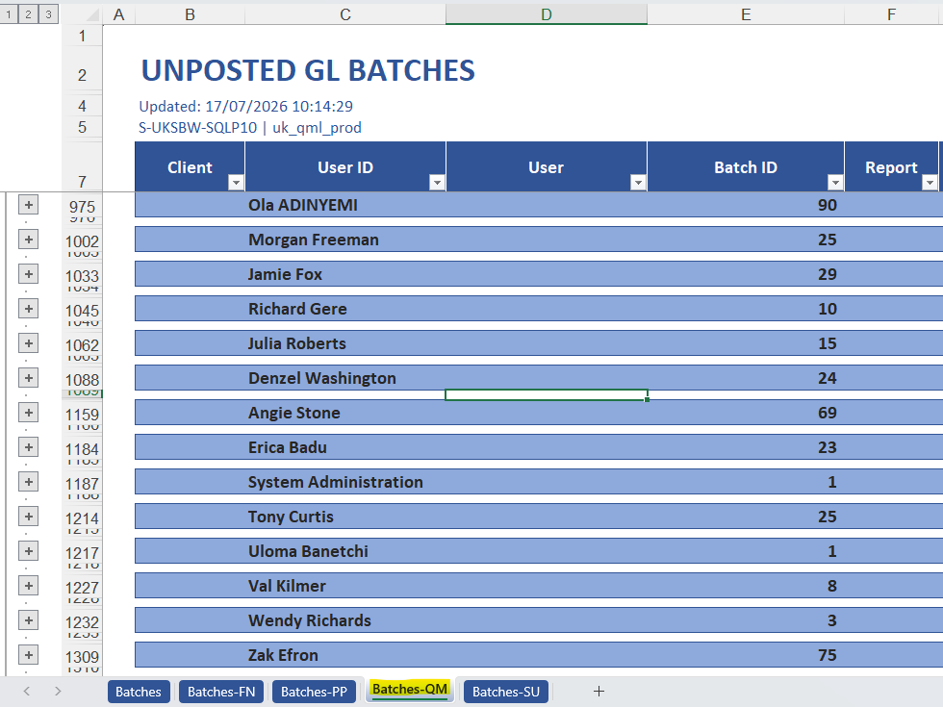
Report Output - Example
Who does what?
Step 1
Select the download excel file
Enable Editing
Step 2
Select Batches – QM
Drill down on user ID to see batch detail
Notes:
Position this as a practical working model and confirm where there are exceptions. The meeting invite explicitly states the need to clarify responsibilities between Finance users and Finance Systems.
[Sources]
- Meeting invite states the session covers responsibilities of Finance users versus the Finance Systems team, escalation routes and support arrangements. Reference: turn1search3.
- Visual on this slide was generated with Microsoft Copilot.

Slide 9
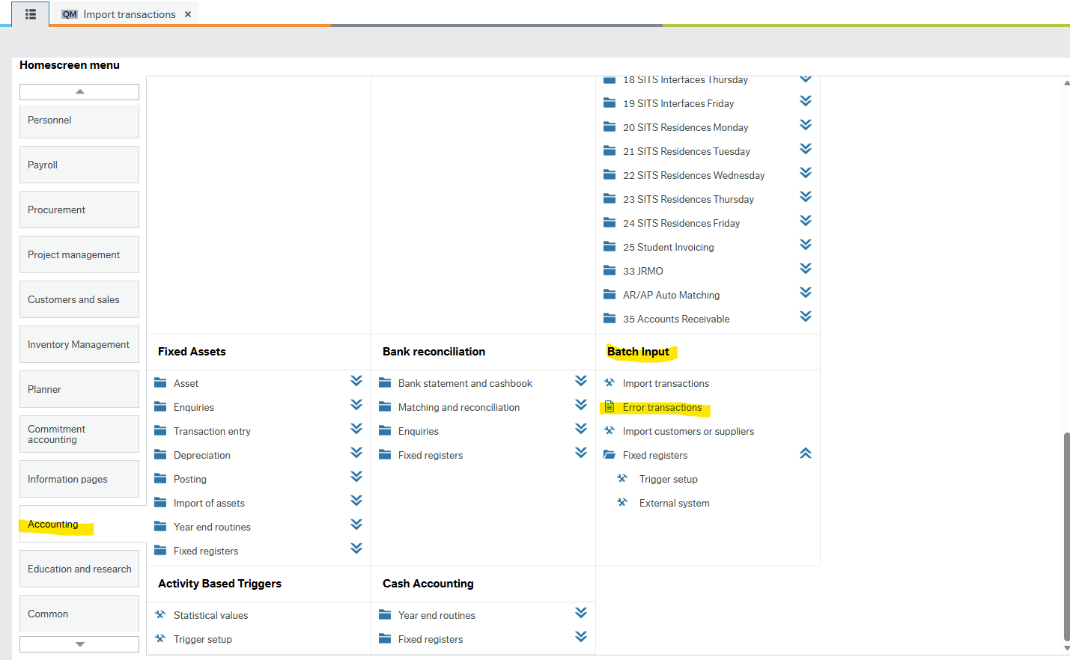
Visibility of BIM items - BIM
Who does what?
Homescreen menu - Unit4 ERP
Navigation Path: Accounting / Batch Input / Error Transactions
Notes:
Position this as a practical working model and confirm where there are exceptions. The meeting invite explicitly states the need to clarify responsibilities between Finance users and Finance Systems.
[Sources]
- Meeting invite states the session covers responsibilities of Finance users versus the Finance Systems team, escalation routes and support arrangements. Reference: turn1search3.
- Visual on this slide was generated with Microsoft Copilot.

Slide 10
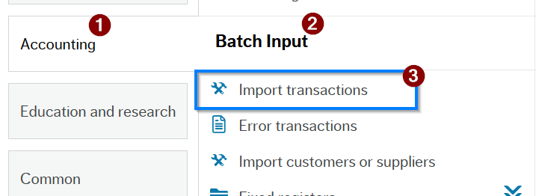
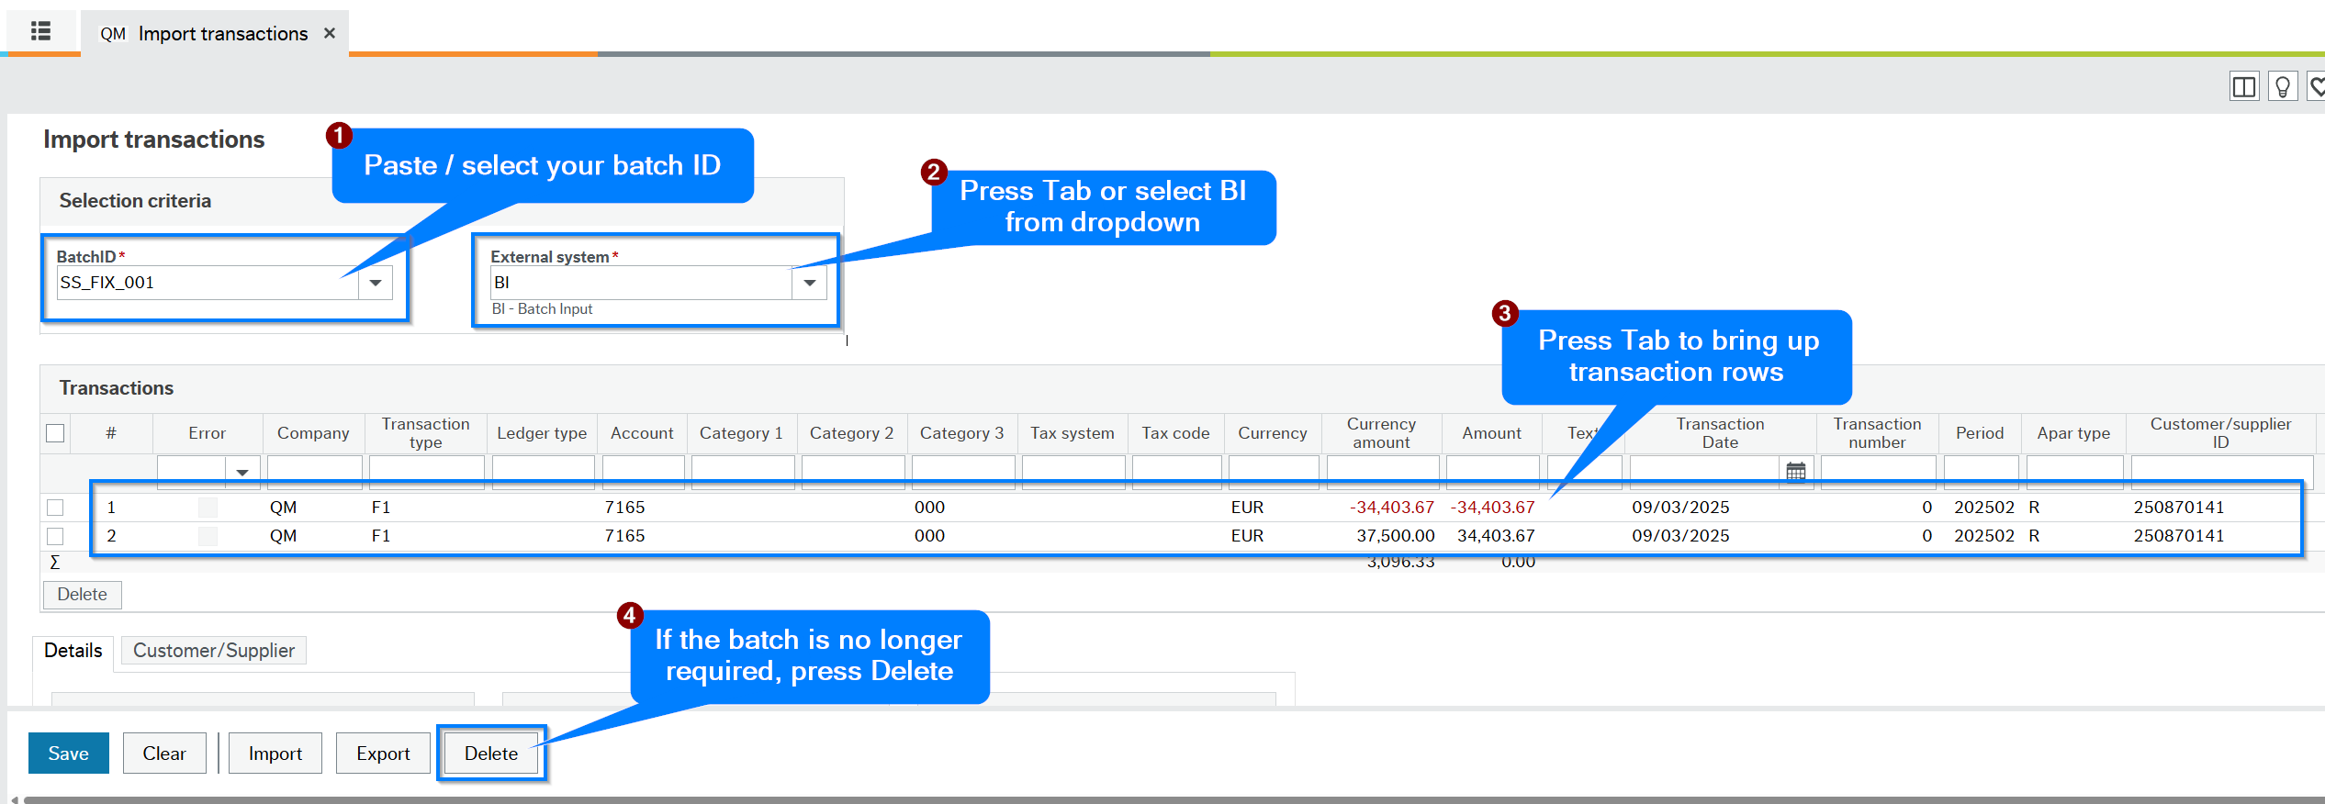
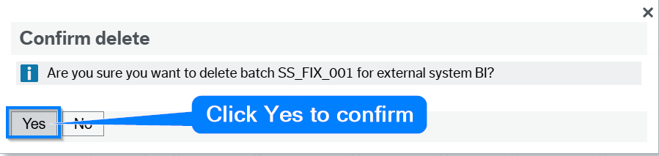
Import Transactions – Corrections and or deletions
Who does what?
Homescreen menu - Unit4 ERP
Step A
Navigation Path: Accounting / Batch Input / IMPORT TRANSACTIONS
Step B
Insert Batch ID / External system = BI / TAB
Select
Select YES to delete to save the deletion
Step C
Notes:
Position this as a practical working model and confirm where there are exceptions. The meeting invite explicitly states the need to clarify responsibilities between Finance users and Finance Systems.
[Sources]
- Meeting invite states the session covers responsibilities of Finance users versus the Finance Systems team, escalation routes and support arrangements. Reference: turn1search3.
- Visual on this slide was generated with Microsoft Copilot.

Slide 11
Why has my transaction appeared in BIM?
Who does what?
Homescreen menu - Unit4 ERP
Navigation Path: Accounting / Batch Input / IMPORT TRANSACTIONS
🤔A transaction will typically appear in Batch Input Maintenance when Unit4 identifies
    a validation error
or
    missing information during processing.
Common causes include:
❌ Invalid account codes
❌ Closed accounting periods
❌ Invalid cost centres or projects
❌ Missing mandatory fields
❌ Incorrect VAT codes
❌ Budget validation failures
❌ User input errors within an upload file
❌ Interface data quality issues
Notes:
Position this as a practical working model and confirm where there are exceptions. The meeting invite explicitly states the need to clarify responsibilities between Finance users and Finance Systems.
[Sources]
- Meeting invite states the session covers responsibilities of Finance users versus the Finance Systems team, escalation routes and support arrangements. Reference: turn1search3.
- Visual on this slide was generated with Microsoft Copilot.

Slide 12
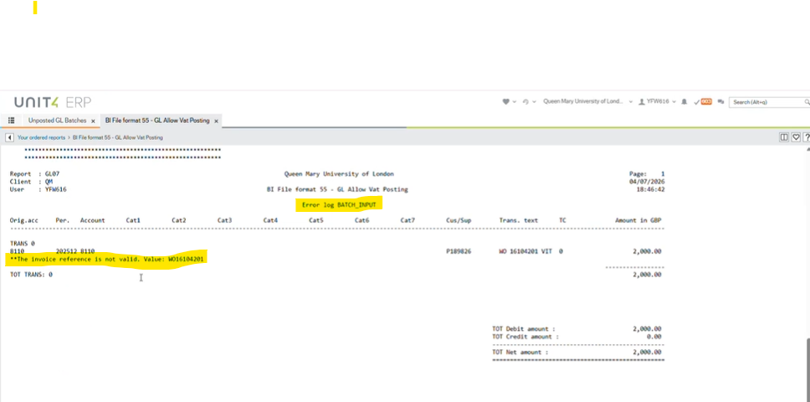
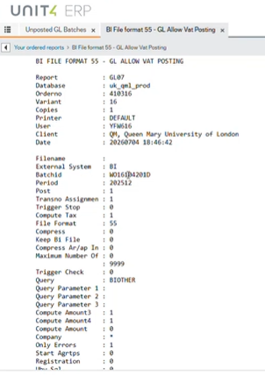
Processing report – ERROR – example 1
Who does what?
Example of ERROR processing report
Correction required: Invalid invoice reference number
Debits / credits = should be equal
Notes:
Position this as a practical working model and confirm where there are exceptions. The meeting invite explicitly states the need to clarify responsibilities between Finance users and Finance Systems.
[Sources]
- Meeting invite states the session covers responsibilities of Finance users versus the Finance Systems team, escalation routes and support arrangements. Reference: turn1search3.
- Visual on this slide was generated with Microsoft Copilot.

Slide 13
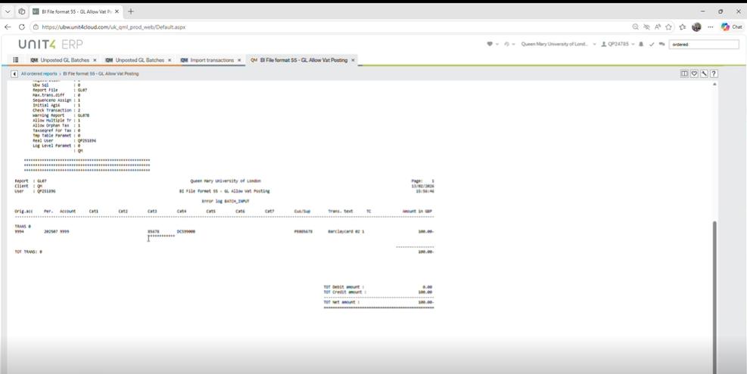
Processing report – ERROR – example 2
Who does what?
Cat 3 – (resource id incorrect
Notes:
Position this as a practical working model and confirm where there are exceptions. The meeting invite explicitly states the need to clarify responsibilities between Finance users and Finance Systems.
[Sources]
- Meeting invite states the session covers responsibilities of Finance users versus the Finance Systems team, escalation routes and support arrangements. Reference: turn1search3.
- Visual on this slide was generated with Microsoft Copilot.

Slide 14
Common causes of posting or validation issues
Trainer-led examples
Source file/data issues
Process or timing issues
Missing mandatory details
Incorrect coding or attributes
Format problems
Incomplete supporting information
File already processed - Duplicate submission
Processing out of sequence
Month-end pressure
User action issues
System or interface issues
Amending without root cause
Repeated changes
Unclear ownership / no remedial actions
Insufficient escalation detail
Import/interface failure
Unexpected validation response (file format error)
Role/menu access issue
Needs Finance Systems review – (closed posting cycle)
Notes:
These are suggested categories for the discussion and should be adapted to the real examples you want to demonstrate. Avoid presenting them as an exhaustive list unless you have confirmed current Unit4 examples.
[Sources]
- Meeting invite states the session covers common causes of posting errors and examples of common issues. Reference: turn1search3.

Slide 15
Deleting Unposted Batches – When to…..
Who does what?
Homescreen menu - Unit4 ERP
Navigation Path: Accounting / Batch Input / IMPORT TRANSACTIONS
🤔 When Should I Delete a Batch?
A batch can usually be deleted if:
✅ The journal is no longer required
✅ A replacement journal has already been created
✅ The batch was created in error
✅ The journal will never be posted to the General Ledger
⚠️ Do NOT delete a batch if:
❌ You still intend to amend and post the journal
❌ The journal is awaiting approval or investigation
❌ You are unsure whether it is still required
💡 Tip: If in doubt, speak to your Finance Manager before deleting the batch.
Notes:
Position this as a practical working model and confirm where there are exceptions. The meeting invite explicitly states the need to clarify responsibilities between Finance users and Finance Systems.
[Sources]
- Meeting invite states the session covers responsibilities of Finance users versus the Finance Systems team, escalation routes and support arrangements. Reference: turn1search3.
- Visual on this slide was generated with Microsoft Copilot.

Slide 16
Practical scenarios for discussion
Ask: what would you do?
Scenario 1
Scenario 2
A file appears in BIM with a validation error. What should be checked before any amendment?
A transaction has been amended once and still fails. Should the user keep changing it?
Expected response: pause, check, evidence, escalate if unclear.
Expected response: pause, check, evidence, escalate if unclear.
Scenario 3
Scenario 4
The user is unsure whether the issue relates to the source file or Unit4 processing. What evidence should be provided?
Only some lines within a batch have failed. What should be corrected locally and what should be escalated?
Expected response: pause, check, evidence, escalate if unclear.
Expected response: pause, check, evidence, escalate if unclear.
Notes:
Use these to make the session interactive. Ask attendees to identify what they would do and then link answers back to the do/don't guidance and escalation checklist.
[Sources]
- Meeting invite states attendees were invited to send specific scenarios or questions in advance and that the session includes FAQs and common issue examples. Reference: turn1search3.

Slide 17
Do / Don’t guidance for users
Prevent rework and protect auditability
DO
DON’T
✓ Check the batch/error details before acting
✓ Confirm whether the file has already been processed
✓ Correct only where the route is clear and authorised
✓ Record the action taken
✓ Escalate early where the cause is unclear
✕ Make repeated amendments without understanding the failure
✕ Assume BIM entries can be ignored
✕ Re-submit files without checking for duplication
✕ Change data that belongs to another owner
✕ Leave failed items unresolved without escalation
Notes:
Use this as the memorable behavioural slide. Invite attendees to challenge or add examples. Make sure any locally specific rules are confirmed before sharing formal guidance.
[Sources]
- Meeting invite states the session should cover correct actions to mitigate errors and correct when errors occur, and when Finance users should and should not amend batch records. Reference: turn1search3.

Slide 18
Business benefits of managing BIM
Why good BIM handling matters
Reduce delays
Improve data quality
Improve auditability
Avoid reprocessing, duplicated effort and slow resolution of failed files.
Post transaction in a timely manner
Increase confidence that financial data entering Unit4 is accurate and complete.
Are all the transactions in the app that need to be there? What’s Missing?
Ensure corrections follow appropriate channels and leave a clear evidence trail.
Support month-end
Minimise operational risk
Clarify ownership
Reduce avoidable batch-related disruption during key processing periods.
Reduce inconsistent handling of failed transactions and correction uncertainty.
Provide Support & Guidance
Differentiate Finance user actions from Finance Systems support responsibilities.
Notes:
Talk track: connect the training to business benefits, not just system administration. Reinforce that better handling supports accuracy, auditability and faster resolution.
[Sources]
- Meeting invite lists business benefits including reduced processing delays, improved financial data quality, fewer support requests, faster resolution, better month-end efficiency, enhanced auditability, clarified responsibilities and minimised operational risk. Reference: turn1search3.

Slide 19
Correction or escalation decision flow
What should users do when they find a BIM item?
3A. Correct
1. Identify
2. Check
If route is clear and permitted
Capture batch/item details
Can you identify the validation issue?
4. Evidence
5. Resolve
Record action taken or provide support details
Confirm posting or support outcome
3B. Escalate
If unclear, complex or risky
Checkpoint before action
If you cannot explain the failure, the proposed correction and the likely impact, do not continue amending — escalate with evidence.
Notes:
This is a suggested decision flow for training purposes. Use it to prompt discussion rather than as formal policy unless confirmed by Finance Systems governance.
[Sources]
- Meeting invite states the session covers the correct process for correcting or escalating issues, support arrangements and common issues. Reference: turn1search3.

Slide 20
What to include when escalating
Help Finance Systems resolve issues faster
Essential details
Business context
Batch ID / reference
Error message or validation text
Transaction or file name
Date/time issue was identified
What the transaction relates to
Known deadlines or month-end impact
Whether posting is urgent
Who owns the source data
Actions already taken
What you need
Checks completed
Changes made or not made
Whether file was re-submitted
Screenshots where useful
Correction advice
Investigation request
Confirmation before processing
Training/guidance request
Trainer prompt: “Good escalation detail reduces follow-up questions and helps distinguish data, process and system issues.”
Notes:
This slide provides suggested information for support requests. Adapt the wording if your Service Desk template requires specific fields.
[Sources]
- Meeting invite states the session covers escalation routes and support arrangements. Reference: turn1search3.

Slide 21
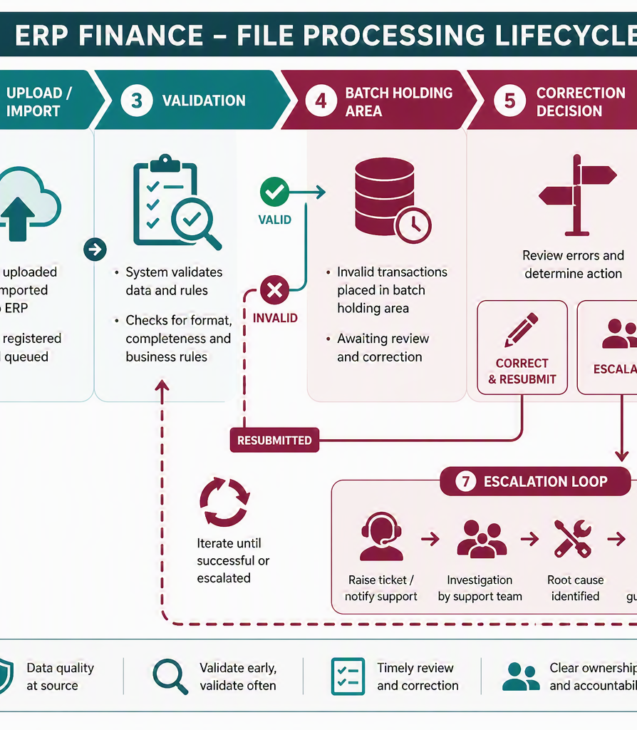
Responsibilities and handoffs
Who does what?
RACI- view
Finance users
Check source context, review known validation issues, make permitted corrections only.
Finance Systems
Investigate system/interface issues, advise on complex failures, support escalations.
Departments / owners
Ensure source data and supporting information are accurate and complete.
Service route
Provide batch ID, error text, file/source details, action already taken and urgency.
Notes:
Position this as a practical working model and confirm where there are exceptions. The meeting invite explicitly states the need to clarify responsibilities between Finance users and Finance Systems.
[Sources]
- Meeting invite states the session covers responsibilities of Finance users versus the Finance Systems team, escalation routes and support arrangements. Reference: turn1search3.
- Visual on this slide was generated with Microsoft Copilot.

Slide 22
Golden rules - Review • Investigate • Correct • Delete (where appropriate) ✅
Keep this as the final takeaway
1
Check before changing
2
Understand the error, not just the symptom
3
Avoid duplicate action
4
Capture evidence
5
Escalate early if unclear
6
Protect auditability
7
Support clean month-end processing
Thank you — questions and examples are welcome.
Notes:
Use this final slide as the takeaway. Reinforce that the goal is clear ownership, fewer avoidable errors and consistent handling.
[Sources]
- Meeting invite states expected outcomes include understanding why transactions appear in BIM, identifying validation errors, avoiding common failures, responsibilities and correct escalation/correction process. Reference: turn1search3.

Slide 23
Wrap-up and follow-up
Recording, wider session and next steps
Recording and reference
Wider audience
Feedback loop
Recordings
Procedure notes
FAQ’s
All to be published: Online Finance Training - Finance
Initial session = users with identified BIM items/responsibility
Further session = users with transaction posting access.
Future = Intel Alerts – failed batches notification sent to user
Questions & feedback will be used to refine guidance, examples, support wording and follow-up communications.
The success measure from today is fewer avoidable BIM errors, clearer ownership, faster resolution and better-quality financial data entering Unit4.”
Closing -
Notes:
Close by confirming the recording and asking attendees to submit any additional scenarios. Remind them that a wider session is planned for other users who have relevant transaction posting access.
[Sources]
- Related email confirms the recording is expected to be published. Reference: turn1search1.
- Related email states the initial session targets users with items in BIM and identified posting responsibility, with a further session for other users with role/menu access for transaction posting. Reference: turn1search1.

