Slide 1
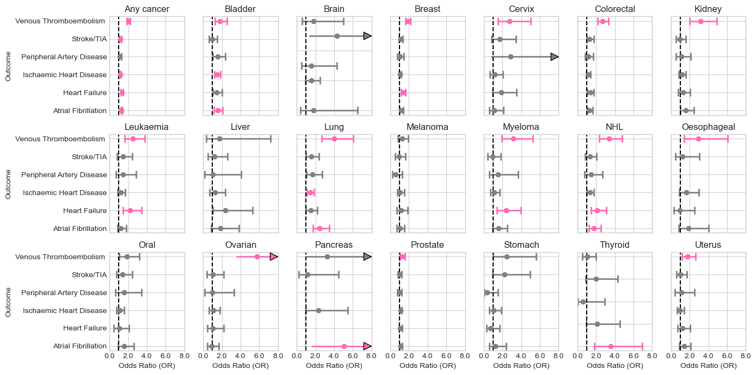
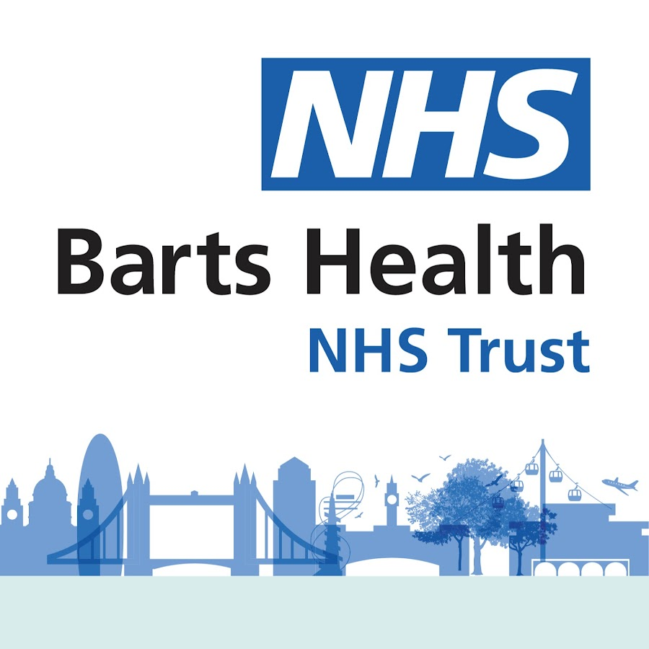
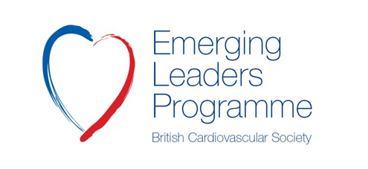
Excess cardiovascular disease burden in cancer survivors in East London
Liliana Szabo^{1,2,3}, Jackie Cooper¹, Dorina-Gabriela Condurache^{1,2}, Isabel Dostal⁴, Gracia Andriamiadana¹, Rohini Mathur⁴, Fiona M. Walter^{4,5}, Mamas A. Mamas^{6,7}, Stefan Neubauer⁸, Nicholas C. Harvey^{9,10}, Charlotte H. Manisty^{2,11}, Steffen E. Petersen^{1,2,13}, John Robson⁴, Zahra Raisi-Estabragh^{1,2}
1. William Harvey Research Institute, NIHR Barts Biomedical Research Centre, Queen Mary University of London, Charterhouse Square, London, EC1M 6BQ, UK , 2. Barts Heart Centre, St Bartholomew’s Hospital, Barts Health NHS Trust, EC1A 7BE, London, UK, 3. Semmelweis University, Budapest, Hungary, 4. Wolfson Institute of Population Health, Queen Mary University of London, London, UK, 5. Department of Public Health and Primary Care, University of Cambridge, Cambridge, UK, 6. Keele Cardiovascular Research Group, Keele University, Keele, UK. 7. Institute of Population Health, University of Manchester, Manchester, UK. 8. Division of Cardiovascular Medicine, Radcliffe Department of Medicine, University of Oxford, National Institute for Health Research Oxford Biomedical Research Centre, Oxford University Hospitals NHS Foundation Trust, Oxford, UK , 9. MRC Lifecourse Epidemiology Centre, University of Southampton, Southampton, UK, 10. NIHR Southampton Biomedical Research Centre, University of Southampton and University Hospital Southampton NHS Foundation Trust, Southampton, UK, 11. Institute of Cardiovascular Science, University College London, London, UK, UK, 13. Health Data Research UK, London, UK
BACKGROUND
RESULTS
Cancer survivorship is improving. Many cancer therapies have a cardiotoxicity profile. Understanding the long-term excess CVD risk of cancer survivors is essential for appropriate service planning.
18,839 cancer survivors and 75,356 matched controls (64±15 years, 43% male) were studied. Cancer survivors had a heightened risk of almost all CVD outcomes considered, with differential risk across cancer types. These appeared independent of shared demographic and traditional vascular risk factors (Figure 1).
AIMS
Figure 1. Association of cancer history with prevalent cardiovascular diseases
To define the excess CVD burden of cancer survivors in East London, independent of shared risk factors and demographics.
METHODS
Electronic health record data from 1.2 million patients registered with primary care services across four boroughs of East London were examined, and cancer statis and CVD profile defined using standardized SNOMED codes. Each cancer exposed patient was match on age and sex to four non-cancer controls. Multivariable logistic regression was used to defined the excess CVD risk in the cancer exposed cohort, while adjusting for additional shared risk factors. Results are displayed as odds ratio, 95% confidence interval, and with multiplicity adjusted p-values.
CONCLUSIONS
Cancer survivors have a heighted risk of a range of CVDs compared to the general population. Our findings highlight the specific healthcare needs of this cohort and inform service planning for this growing vulnerable cohort.

